Slide 1
COURSEWORK REPORT
20 May 2021
Ho Chi Minh University of Technology | Course: Database Security
Professor: Dang Tran Khanh
Student: Lai Trung Minh Duc (duc.lai.imp20@hcmut.edu.vn)

Slide 2
Contents
Idea and Context
Material
Principle (Laplace mechanism)
Result
Conclusion

Slide 3
Context and Idea
THE CONTEXT: I consider the weekly revenue of each store is the sensitive data:
Competitors might meet my outlets and offer some deals
Revenue information is a criteria to do incentive program
But I also want to do some Data Science analysis on this revenue to do cluster, and machine learning forecasting (which mainly focus on MEAN, STD).
THE IDEA: Using Differential Privacy technique (Laplace mechanism)

Slide 4
Material
Input: The Raw revenue of outlet data
Output: The anonymized revenue of outlet data
Module: Apply IBM Differential Privacy module for Python URL: https://github.com/IBM/differential-privacy-library
Submission:
Input and Output
Python code for Differential Privacy

Slide 5
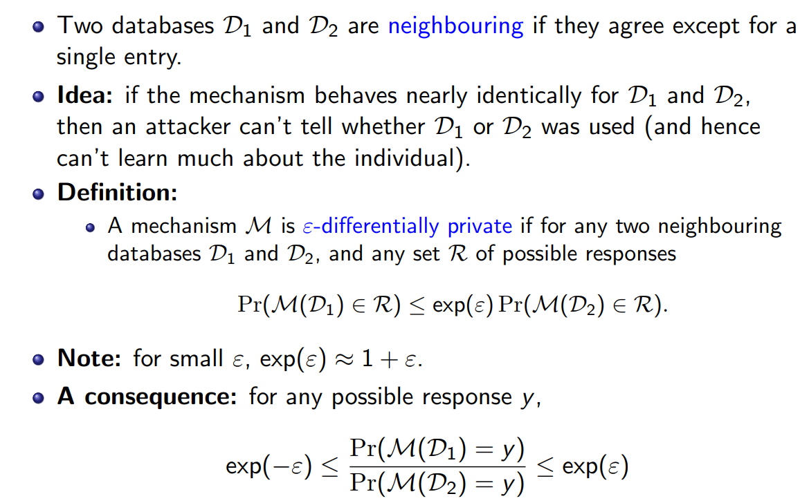
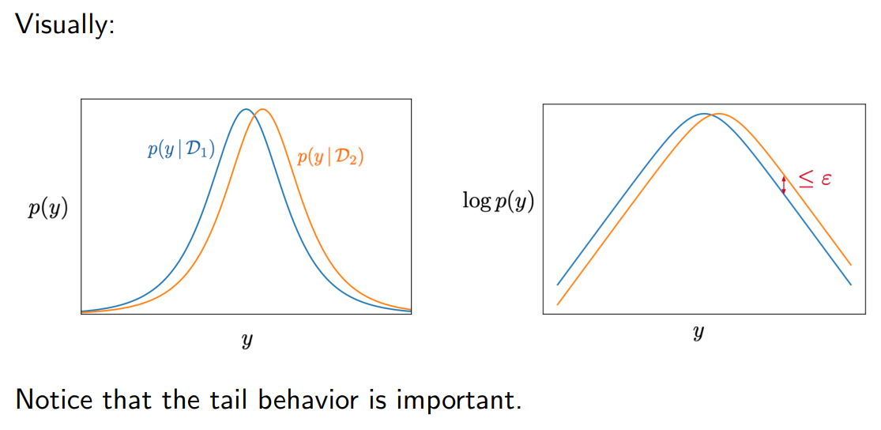
Differential Privacy explained

Slide 6
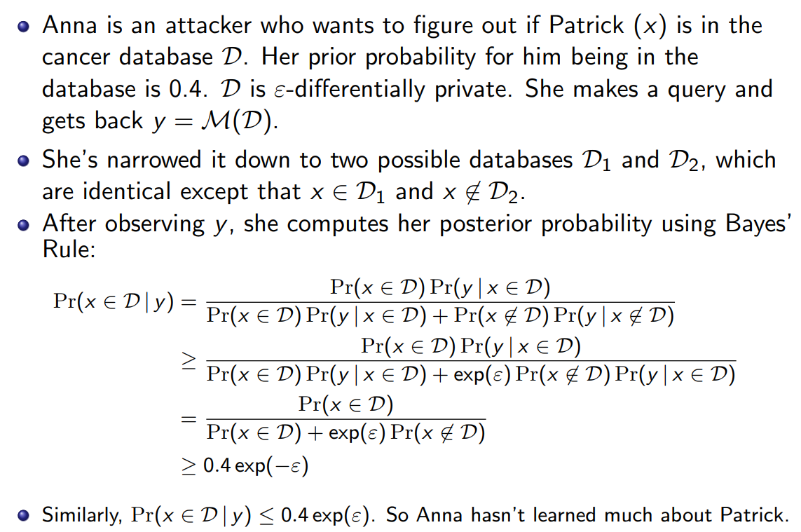
Differential Privacy explained

Slide 7
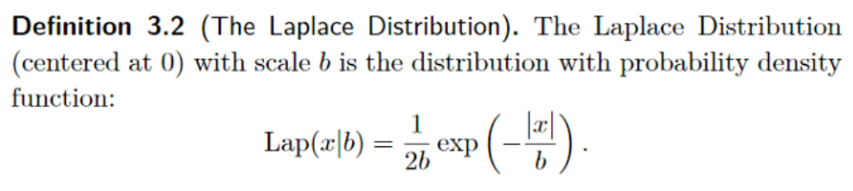
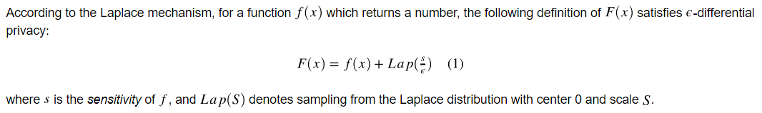
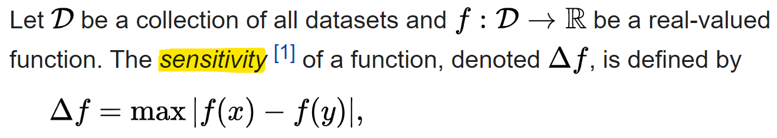
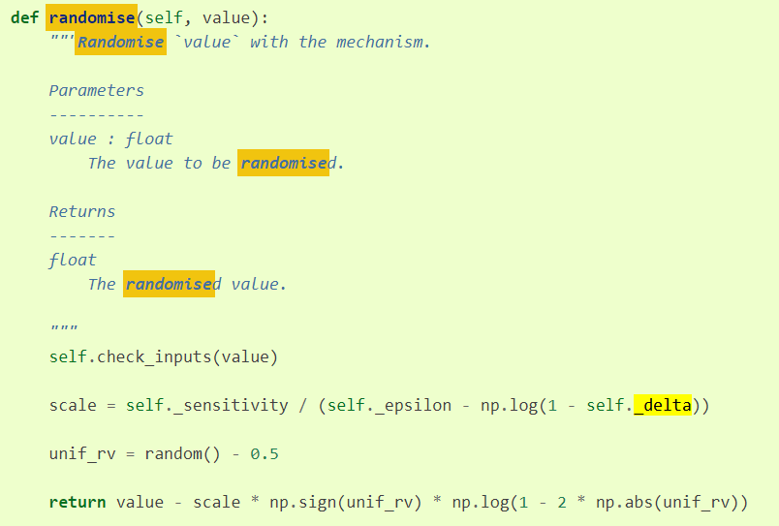
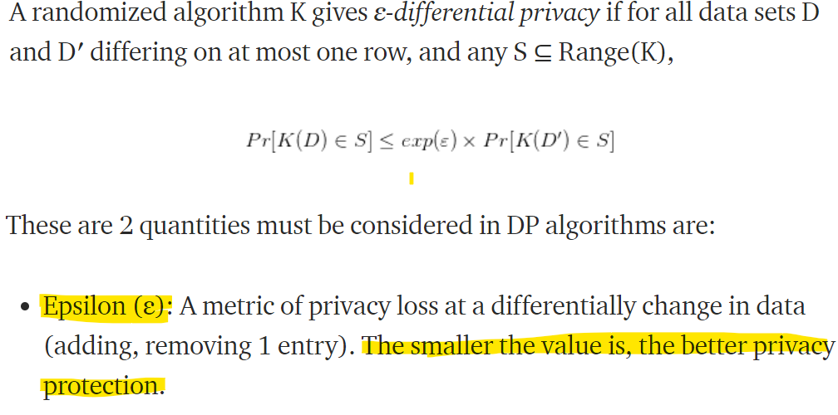
Laplace transform protect DP

Slide 8
DEMO
LINK: https://github.com/LAITRUNGMINHDUC/BKIMP-MasterCS-DatabaseSecurity-Coursework-DifferentialPrivacy

Slide 9
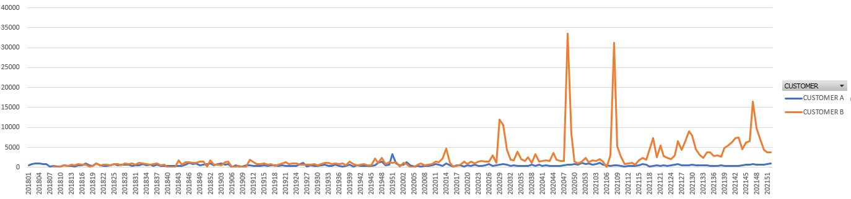
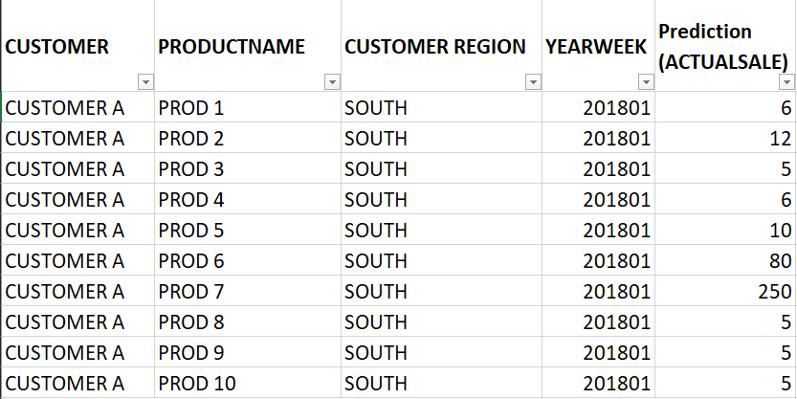
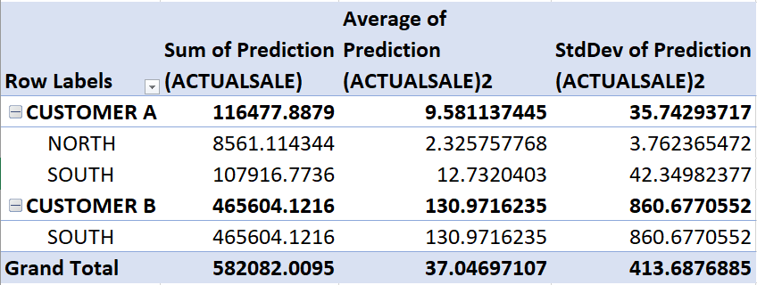
Dataset Input
Time-series by week by customer by product from 2018 to 2021

Slide 10
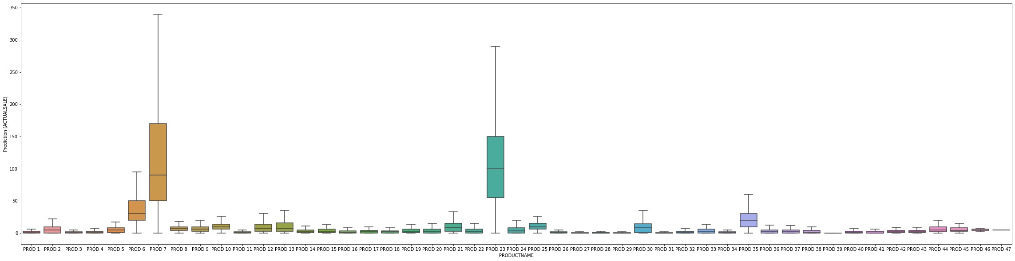
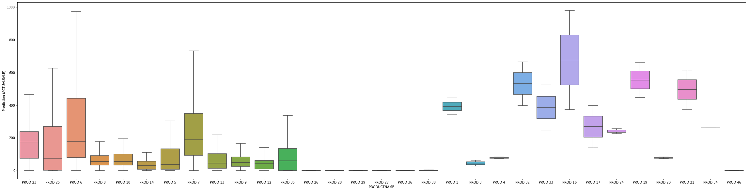
CUSTOMER A – BOX PLOT
CUSTOMER B – BOX PLOT

Slide 11
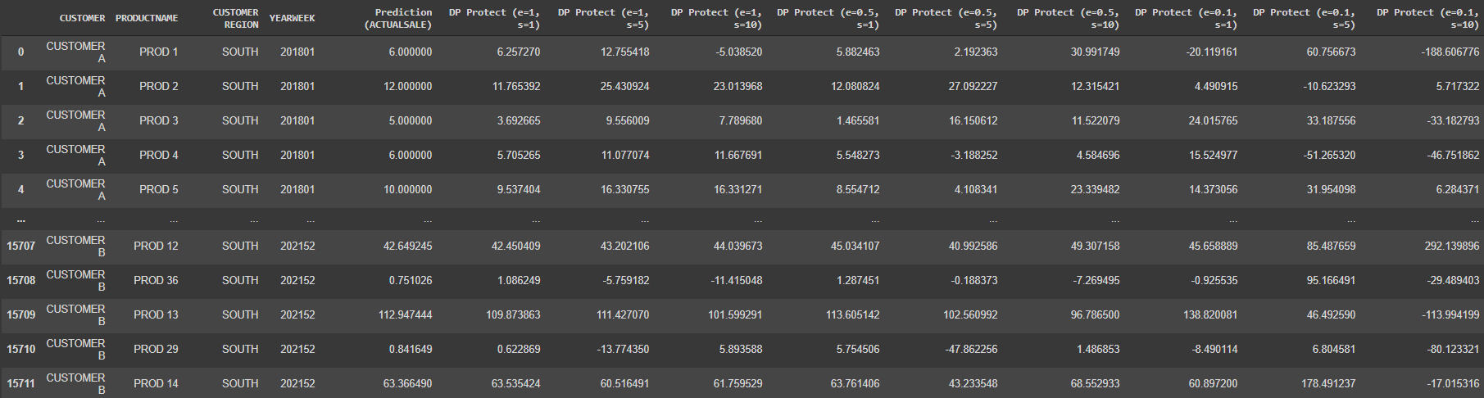
Dataset Output

Slide 12
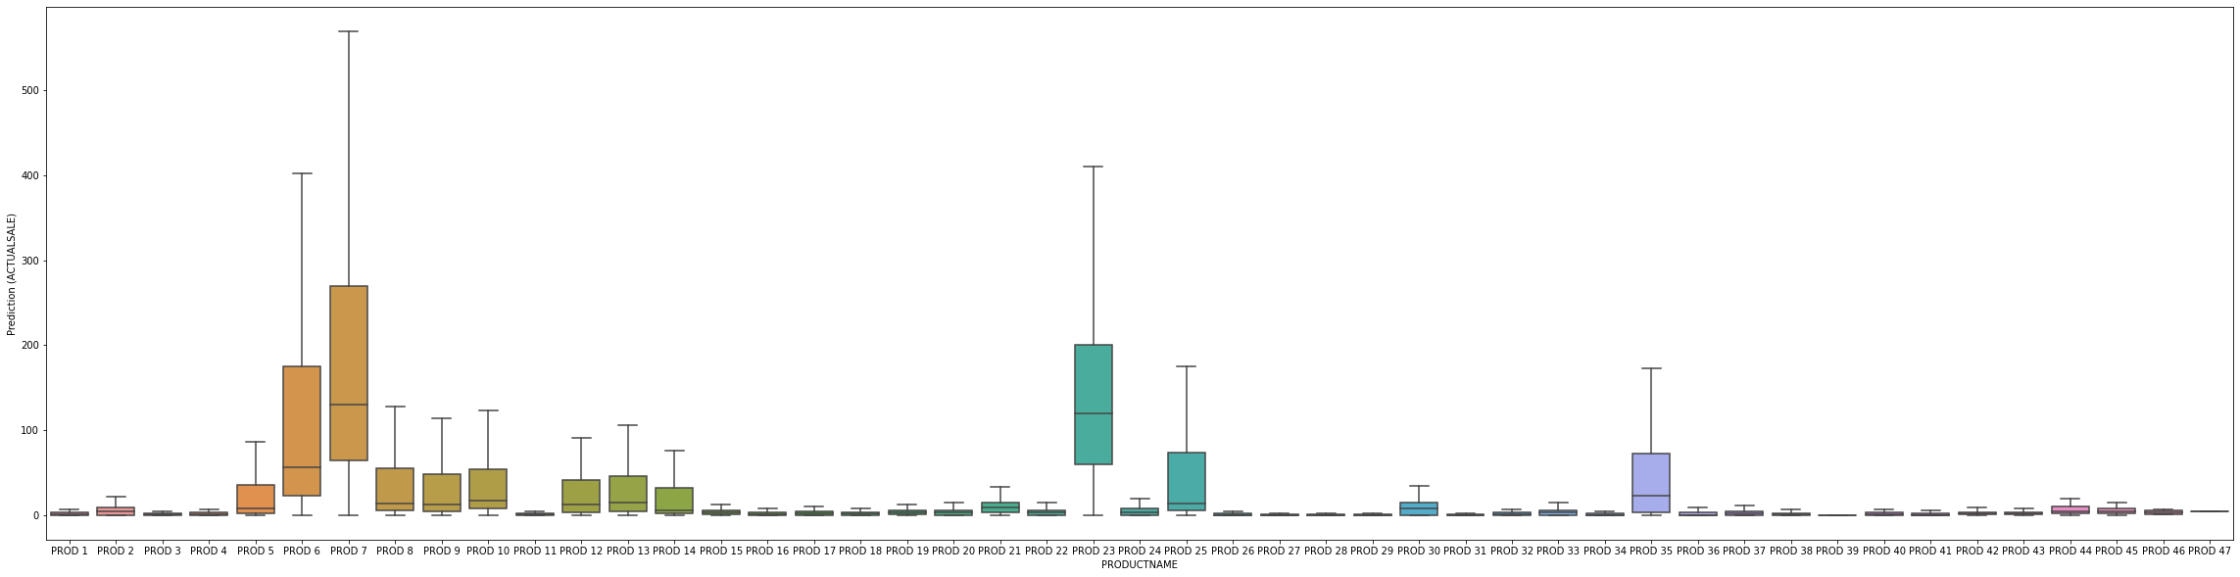
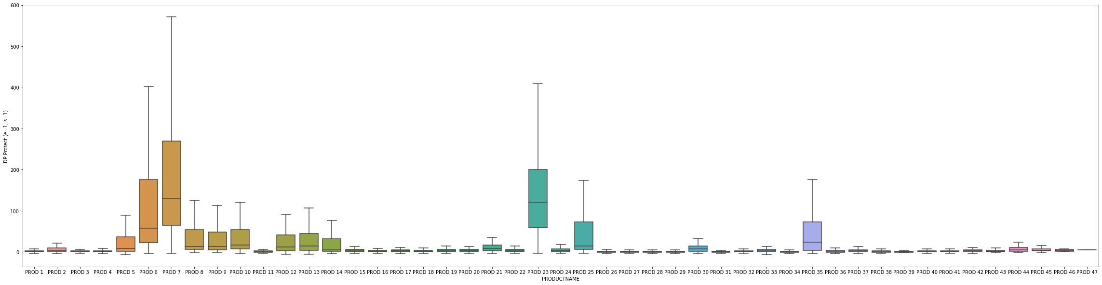
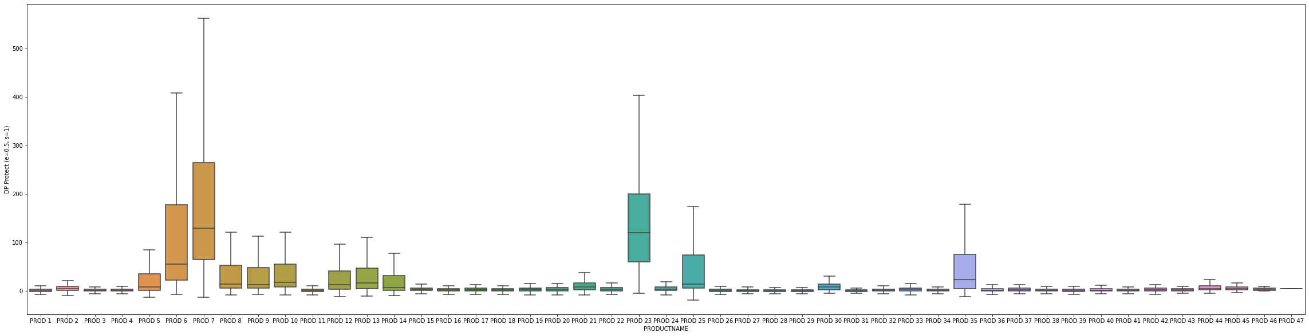
CUSTOMER B - BOXPLOT
ACTUAL VALUE
NOTE:
Data Distribution is reserved after running through the Differential Privacy solution, which is good for data science analysis.
E=1, S=1
E=0.5, S=1

Slide 13
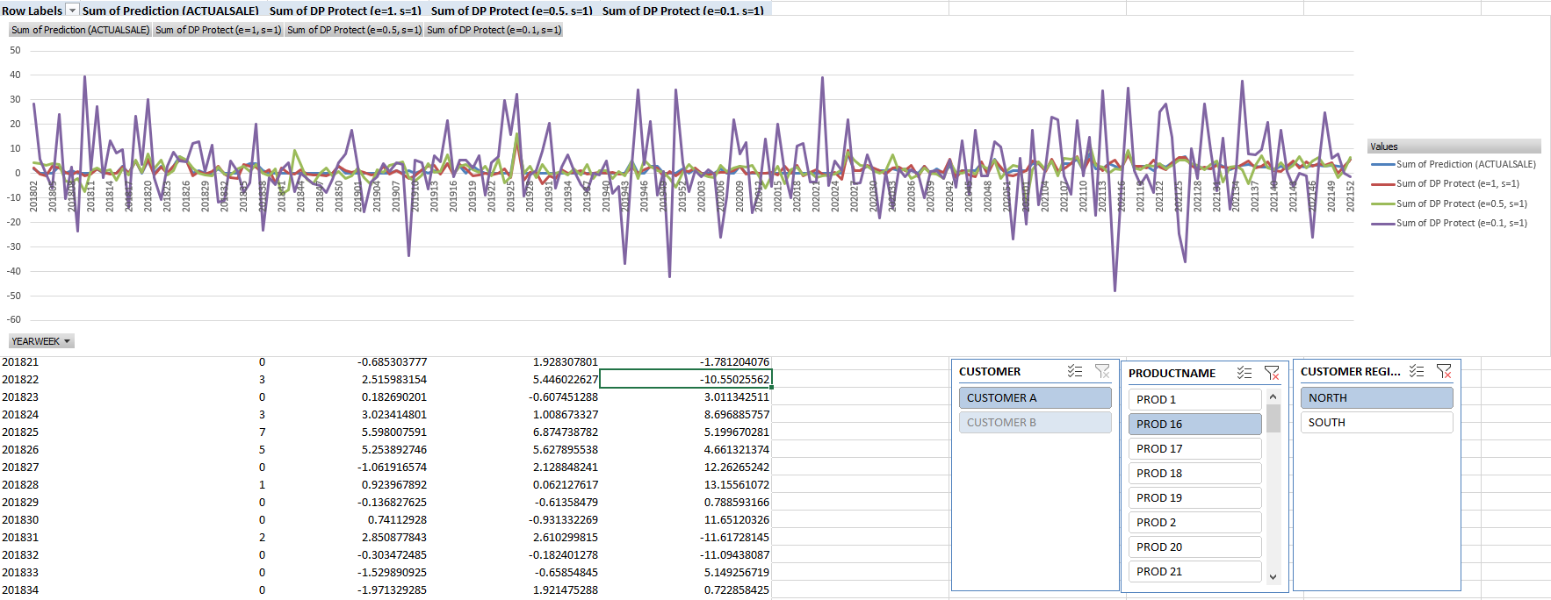
CUSTOMER A – PROD 16 - NORTH
NOTE: However, the DP-version makes the data quite chaos at detail level (time-series)
We must choose the reasonable epsilon to keep the data seasonality + data pattern.

Slide 14
Conclusion
DP-solution with Laplace mechanism is a good idea for protect the dataset. It keeps the data distribution while make noise in individual records.
Epsilon parameter must be chosen carefully to balance between privacy + analytical ability of the data.

Slide 15
REFERENCE
Differential Privacy – Simply Explained https://www.youtube.com/watch?v=gI0wk1CXlsQ
The Laplace Mechanism (Proof of Differential Privacy) | Lê Nguyên Hoang: https://www.youtube.com/watch?v=aXeFtubk634
Interpretation of the ε and δ s of Differential Privacy | Lê Nguyên Hoang: https://www.youtube.com/watch?v=REAo31p5wSo
Diffprivlib: The IBM Differential Privacy Library: https://arxiv.org/abs/1907.02444
Understanding Differential Privacy: https://towardsdatascience.com/understanding-differential-privacy-85ce191e198a

Slide 16
THANK YOU

